Slide 1
DEPARTMENT OF COMPUTER SCIENCE
Sellgros
Submitted By: Sarvesh, vidyabhushan, Skanda

Slide 2
Database Design
Introduction
Database is a collection of related data. Relational database stores data in a table or relations. The data stored in a relation are arranged in records. Each record consists of set of attributes. Fields can be referred to characteristics of records. This document describes the table that is used to design software, its attributes, data types, constraints and relationship among those tables.

Slide 3
The design process consists of the following steps:
Determine the purpose of your database. Find and organize the information required.
Divide the information into tables. Turn information items into columns...
Specify primary keys.
Set up the table relationships.
Refine your design.
Apply the normalization rules.

Slide 4
Purpose and Scope
Purpose
Avoid Redundant Data
The table in the database should be constructed following standards and with utmost dedication. It should have different fields and minimize redundant data. The table should always have a Primary Key that would be a unique id.
Faultless Information
The database should follow the standards and conventions and provide meaningful information useful to the organization. (Constraint)
Data Integrity
Integrity assists in guaranteeing that the values are valid and faultless. Data Integrity is set to tables, relationships, etc.
Modify
The database developed should be worked upon with the conventions and standards, so that it can be easily modified whenever the need arises.

Slide 5
Scope
Normalization of Database.
Imposing Integrity Constraint.
Establishing the Relation between the tables.
Accessing the data from multiple tables. (Usage of join and sub query….)

Slide 6
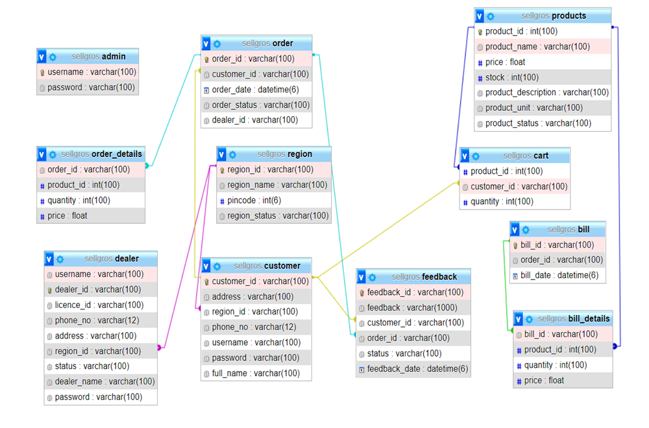
Database schema

Slide 7
Table Definition
DEALER TABLE
Column name | Data type | Size | Constraint | Description
username | varchar | 100 | Not null | User name of the dealer
dealer_id | varchar | 100 | Not null (primary key) | Id of the dealer
licence_id | varchar | 100 | Not null | License id of dealer
phone_no | varchar | 12 | Not null | Phone no. of the dealer
address | varchar | 100 | Not null | Address of the dealer
region_id | varchar | 100 | Not null (foreign key) | Region_id of the dealer
status | varchar | 100 | Not null | Status of the dealer
dealer_name | varchar | 100 | Not null | Name of the dealer
Password | varchar | 100 | Not null | Password of the dealer

Slide 8
Customer table
Column name | Data type | Size | Constraint | Description
customer_id | Varchar | 100 | Not null (primary key) | Id of the customer
address | Varchar | 100 | Not null | Address of the customer
region_id | Varchar | 100 | Not null (foreign key) | Region_id of the customer
phone_no | Varchar | 12 | Not null | Phone no. of the customer
username | Varchar | 100 | Not null | Username of the customer
password | Varchar | 100 | Not null | Password of the customer
full_name | Varchar | 100 | Not null | Fullname of the customer

Slide 9
Admin table
Column name | Data type | Size | Constraint | Description
username | Varchar | 100 | Not null | Username of the admin
password | Varchar | 100 | Not null | Password of the admin

Slide 10
Region table
Column name | Data type | Size | Constraint | Description
region_id | varchar (primary key) | 100 | Not null | Id of the region
region_name | Varchar | 100 | Not null | Name of the region
pincode | Int | 6 | Not null | Pin code for the region
Region_status | varchar | 100 | Not null | Status of the Region

Slide 11
product table
Column name | Data type | Size | Constraint | Description
product_id | Int | 100 | Not null (primary key) | Id of the product
product_name | Varchar | 100 | Not null | Name of the product
Price | Float |  | Not null | Price of the product
Stock | Int | 100 | Not null | Stock of the project
product_description | Varchar | 100 | Not null | Description of the product
product_unit | Varchar | 100 | Not null | Unit of the product
Product _status | varchar | 100 | Not null | Status of the product

Slide 12
order table
Column name | Data type | Size | Constraint | Description
order_id | Varchar | 100 | Not null (primary key) | Id of the order
customer_id | Varchar | 100 | Not null (foreign key) | Id of the customer
order_date | Datetime | 6 | Not null | Date of the order
order_status | Varchar | 100 | Not null | Status of the order
dealer_id | Varchar | 100 | null | Id of the dealer

Slide 13
order_details table
Column name | Data type | Size | Constraint | Description
order_id | Varchar | 100 | Not null (foreign key) | Id of the order
product_id | Int | 100 | Not null (foreign key) | Id of the products
quantity | Int | 100 | Not null | Quantity of the product
price | float |  | Not null | Price of the product

Slide 14
cart table
Column name | Data type | Size | Constraint | Description
product_id | Int | 100 | Not null (foreign key) | Id of the products
customer_id | Varchar | 100 | Not null (foreign key) | Id of the customer
quantity | Int | 100 | Not null | Quantity of the product

Slide 15
bill table
Column name | Data type | Size | Constraint | Description
Bill_id | Varchar | 100 | Not null(primary key) | Id of the bill
Order_id | Varchar | 100 | Not null | Id of the order
Bill_date | Datetime | 6 | Not null | Date of the bill

Slide 16
bill_details table
Column name | Data type | Size | Constraint | Description
Bill_id | Varchar | 100 | Not null (foreign key) | Id of the bill
Product_id | Varchar | 100 | Not null (foreign key) | Id of the products
quantity | Int | 100 | Not null | Quantity of the products
price | Float |  | Not null | Price of the products

Slide 17
Feedback table
Column name | Data type | Size | Constraint | Description
feedback_id | Varchar | 100 | Not null (primary key) | Id of the feedback
feedback | Varchar | 1000 | Not null | Feedback about order and dealer
customer_id | Varchar | 100 | Not null (foreign key) | Id of the customer
order_id | Varchar | 100 | Not null (foreign key) | Id of the order
status | Varchar | 100 | Not null | Status of the feedback
feedback_date | Datetime | 6 | Not null | Date of the feedback

Slide 18
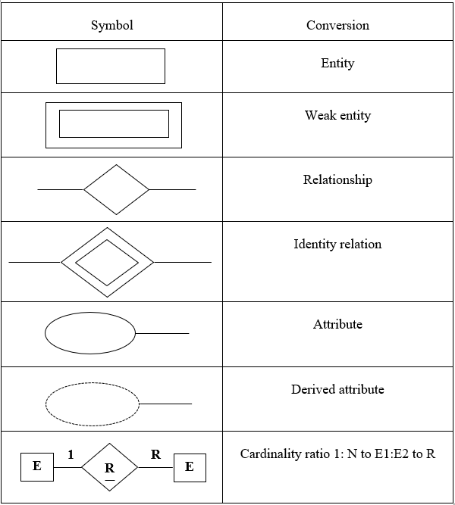
ER DIAGRAM

Slide 19
region_id
Region_id
address
status
Region_name
has
n
1
phone_no
Dealer
Region
pincode
licence_id
username
1
Region_status
has
dealer_id
dealer_id
password
Phone_no
password
n
Region_id
n
give
1
order_id
Customer
A
username
feedback_id
1
customer_id
status
feedback
address
feedback
place
Full_name
feedback_date
1
customer_id
has
order_status
n
dealer_id
order_id
Order
B
n
order_date
customer_id

Slide 20
A
1
adds
n
Product_id
Cart
Customer_id
n
quantity
has
stock
1
Product_description
products
Product_id
Product_unit
Product_name
Order_id
1
Product_id
n
has
quantity
Order_details
n
price
has
bill_id
Order_id
1
bill_date
B
1
have
1
bill
Bill_id
Product_id
n
has
1
Bill_details
quantity
price

Slide 21
THANK YOU

